Slide 1
Render prop
by Yaroslav Vendysh

Slide 2
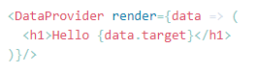
Definition
The term “render prop” refers to a technique for sharing code between
React components using a prop whose value is a function.
A component with a render prop takes a function that returns a React element and calls it instead of implementing its own render logic.
Libraries that use render props include React Router, Downshift and Formik.

Slide 3

D. R. Y.

Slide 4
Problem
Let’s say we were in charge of recreating a dashboard similar to Stripe’s.
As most projects go, everything goes great until the very end.
Just when you think you’re about to be done, you notice that the dashboard has a bunch of different tooltips that need to appear when certain elements are hovered over.

Slide 5

Visualization

Slide 6
Solution
There are a few ways to approach this.
The one you decide to go with is to detect the hover state of the
individual components and from that state, show or not show the tooltip.
There are three components you need to add this hover detection functionality to
Info
TrendChart
DailyChart

Slide 7

Let’s code

Slide 8
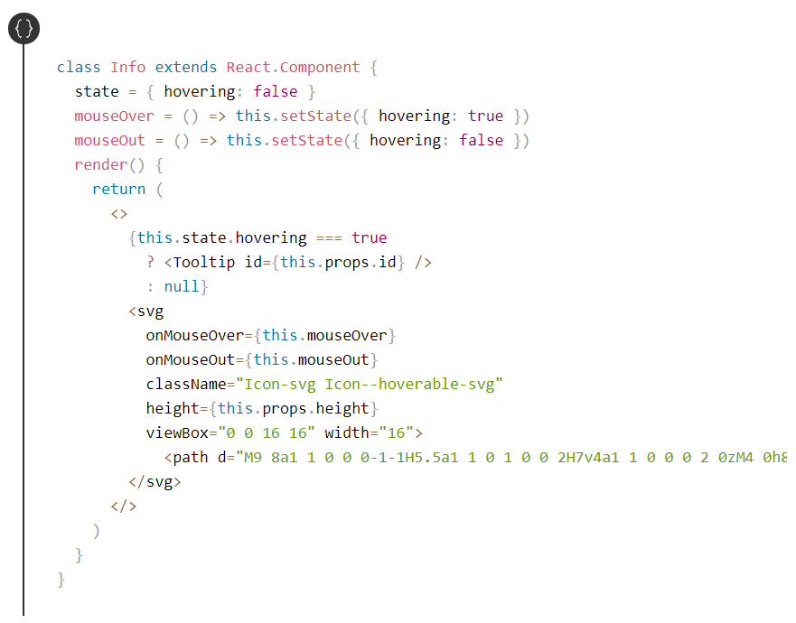
Info

Slide 9
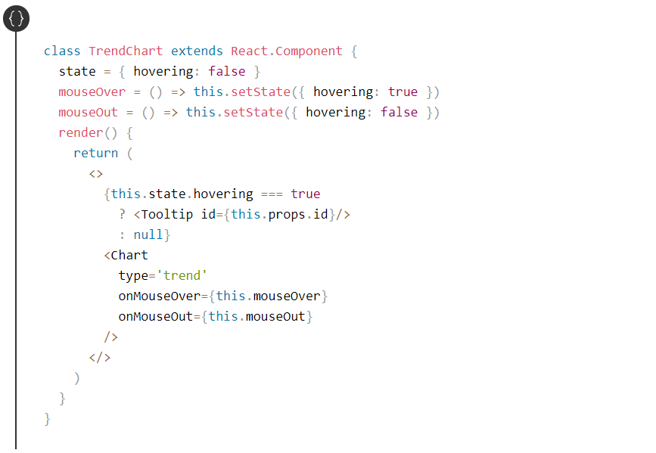
TrendChart

Slide 10
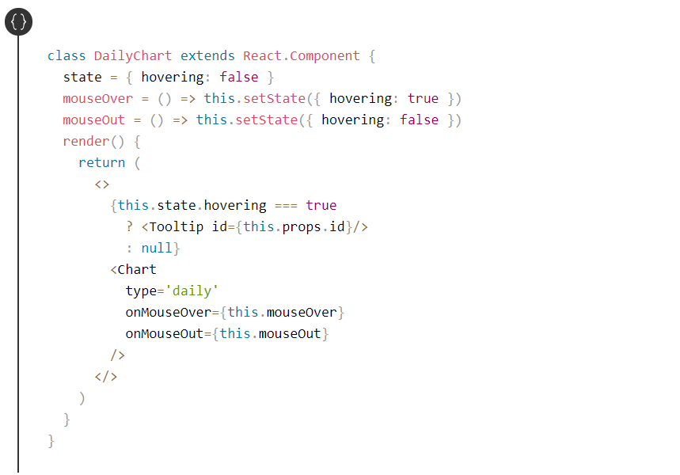
DailyChart

Slide 11

Summary
And with that, we’re all finished. You may have written React like this before.
It’s not the end of the world (#shipit), but it’s not very “DRY”.
As you saw, we’re repeating the exact same hover logic in every one of our components.

Slide 12
Summary
At this point, the problem should be pretty clear, we want to avoid duplicating our hover logic anytime a new component needs it. So what’s the solution?
Well before we get to that, we need to get a refresh on two fundamental aspects of React.
They are components which don’t render UI and passing functions as props.
Don’t render UI
Passing functions as props

Slide 13
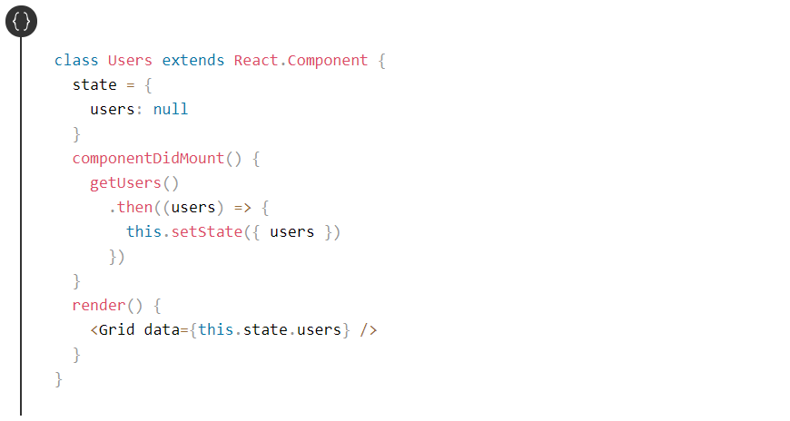
No UI Components
In the example below Users is responsible for getting the users, then passing them to the Grid component. It doesn’t have its own UI, instead, it uses the UI from the Grid component.

Slide 14
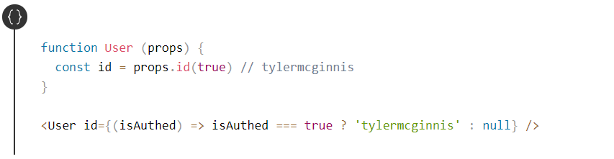
Passing functions as props
As you know, props are part of React’s component API that allow
you to pass data into a component.
Now what if instead of passing a string as a prop, we passed a function?
Now what if we wanted to pass the function prop some data?

Slide 15
Let’s code

Slide 16
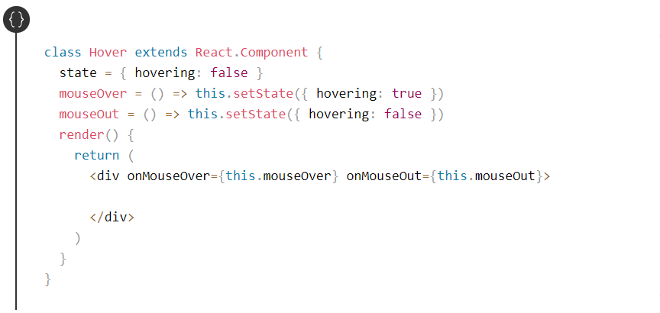
First, we want to create a “Wrapper” component which is responsible for managing the hover state.

Slide 17
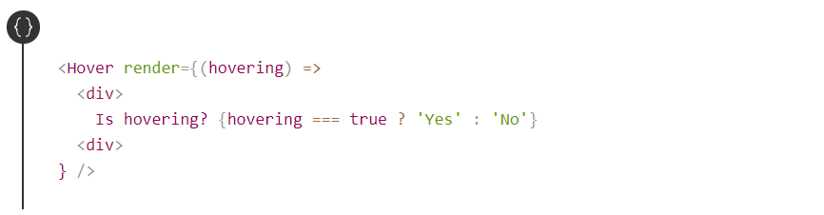
The next question becomes what should Hover render? This is where are function prop knowledge comes into play. Let’s have Hover receive a prop called render.

Slide 18
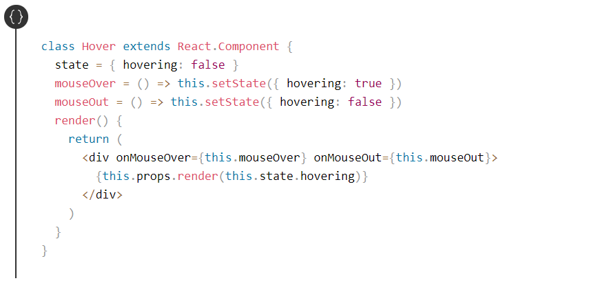
Now the last change we need to make is in our Hover component. All we need to do is invoke this.props.render passing it this.state.hover.

Slide 19
Before / After
Finally let’s head back to the original code we had and
see how we no longer have to duplicate all the hover logic
since we have our Hover component.
This is what we had before and after.

Slide 20
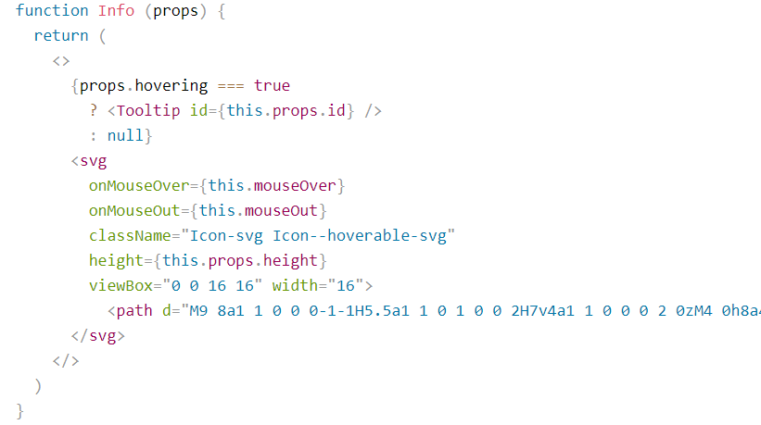
Before / After

Slide 21
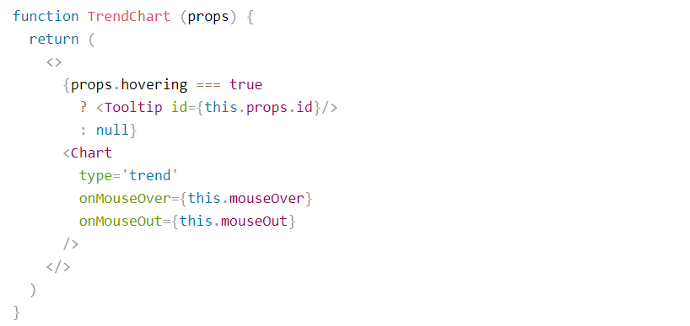
Before / After

Slide 22

Before / After

Slide 23
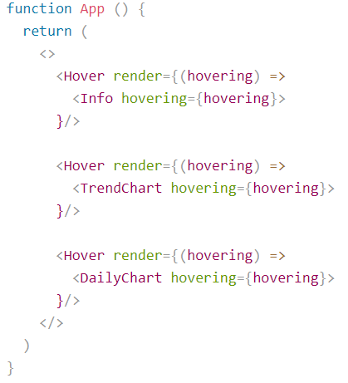
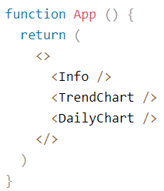
Before / After

Slide 24
Another syntax with children
Another way to utilize the render props pattern is with React’s children prop.
If you’ve never used props.children before, it’s just like any other prop,
accept instead of you passing it explicitly to the component,
React automatically does it for you and it reference whatever is in the body of the component.

Slide 25
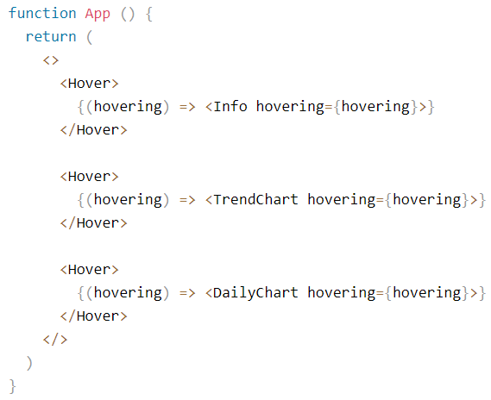
Another syntax with children

Slide 26
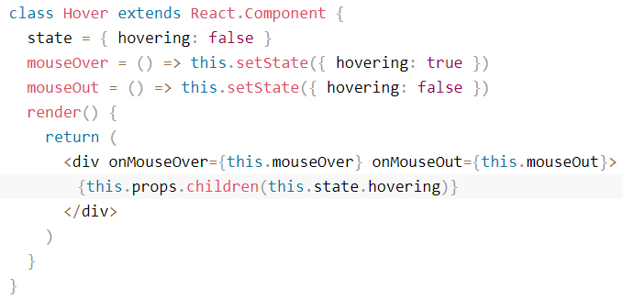
Another syntax with children

Slide 27
What do render props solve?
Reuse code across components when using ES6 classes
The lowest level of indirection - it’s clear which component is called and the state is isolated.
No naming collision issues for props, state and class methods.
No need to deal with boiler code and hoisting static methods.

Slide 28
Minor problems
Caution using shouldComponentUpdate as the render prop might close over data it is unaware of.
There could also be minor memory issues when defining a closure for every render. But be sure to measure first before making performance changes as it might not be an issue for your app.
Another small annoyance is the render props callback is not so neat in JSX as it needs to be wrapped in an expression. Rendering the result of an HOC does look cleaner.

Slide 29
Children pass-through
by Yaroslav Vendysh

Slide 30

Introduction
Use props.children and that’s it. I know everything about children
You are wrong !
Because we’re working with JavaScript, we can change children. We can send special properties to them, decide if we want them to render or not and generally manipulate them to our will. Let’s dig into the power of children in React.

Slide 31
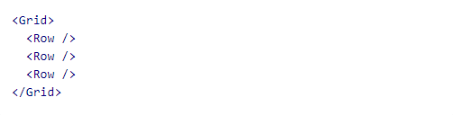
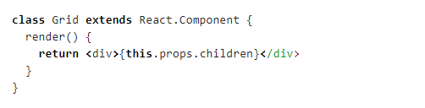
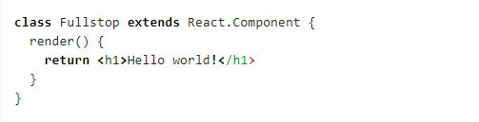
Child components
Using an expression container (that’s the technical term for those squiggly brackets in JSX) parents can render their children. Parents can also decide not to render any children or to manipulate them before rendering.

Slide 32
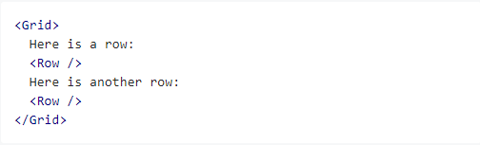
Everything can be a child
Children in React don’t have to be components, they can be anything.
You can also mix and match multiple types of children perfectly fine.

Slide 33
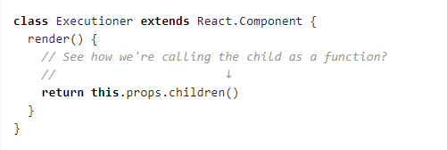
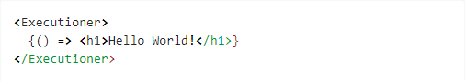
Function as a child
We can pass any JavaScript expression as children.
This includes functions.

Slide 34
Manipulating children
If you take a look at the React docs you will see it says that
“children are an opaque data structure”.
What they are essentially telling us is that props.children can be any type,
such as an array, a function, an object, etc.
Since you can pass anything, you can never know for sure.
React provides a bunch of helper functions to make manipulating children easy and painless. These are available at React.Children.

Slide 35
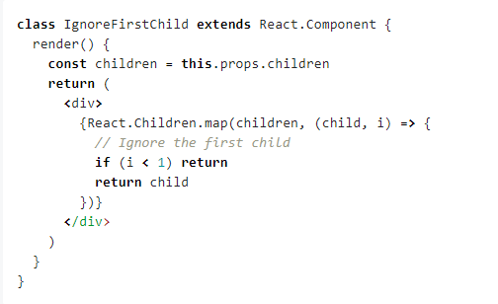
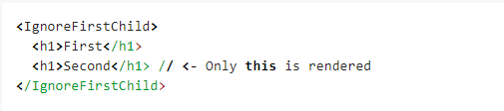
Looping over children
The two most obvious helpers are React.Children.map and React.Children.forEach.
They work exactly like their array counterparts, except they also work when a function,
object or anything is passed as children.

Slide 36
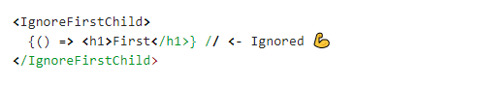
Looping over children
But what would’ve happened if somebody passed a function as a child?
😱

Slide 37
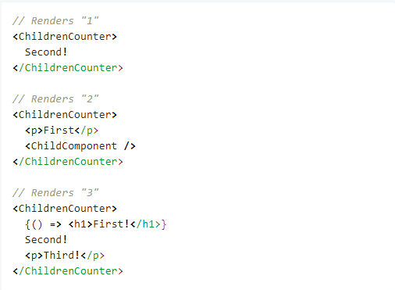
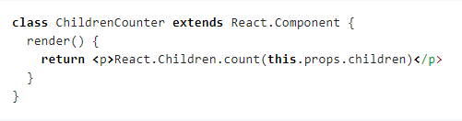
Counting children
Since this.props.children can be any type, checking how many children a component has turns out to be rather hard! Naively doing this.props.children.length ? We’d have one child,
"Hello World!", but the .length would be reported as 12 instead!

Slide 38
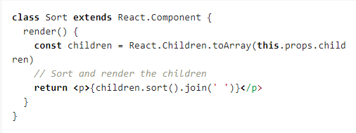
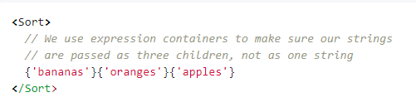
Converting children to an array
As a last resort, if none of the above methods fit your need,
you can convert your children to an array with React.Children.toArray.

Slide 39
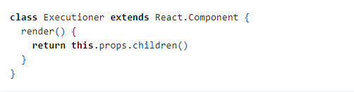
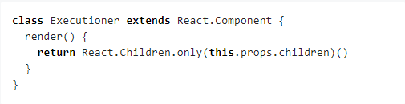
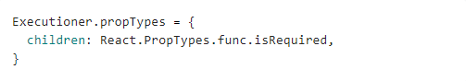
Enforcing a single child
If component expects only a single child to be passed, which has to be a function.
We could try to enforce this.

Slide 40
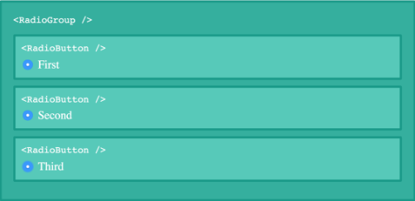
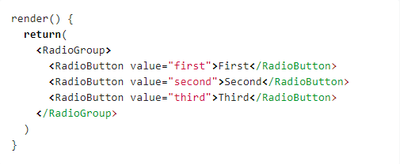
Editing children
We can render arbitrary components as children, but still control them from
the parent instead of the component we render them from.
The RadioButtons are not rendered from the RadioGroup itself, they are used as children.

Slide 41
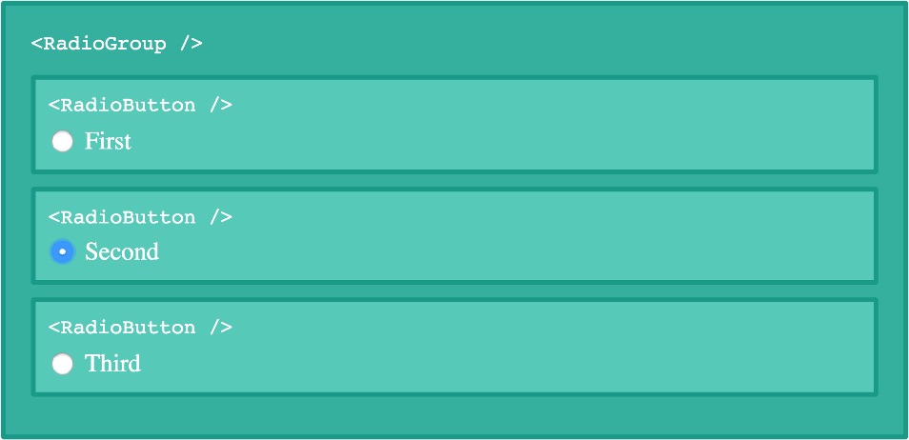
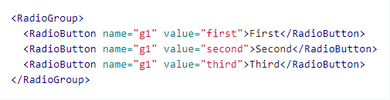
Editing children
To group input tags together they all need to have the same name attribute.
We could of course go through and assign a name property to every single RadioButton.
But that’s a) tedious and b) error prone.

Slide 42
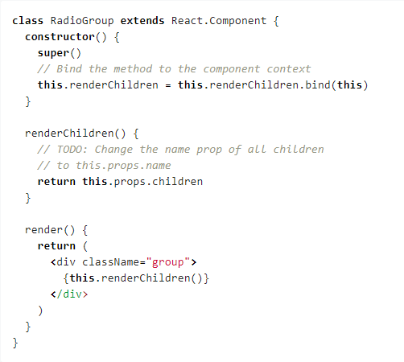
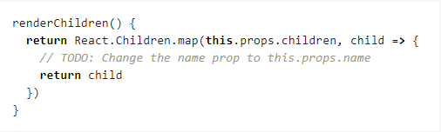
Editing children: changing children props
In our RadioGroup we’ll add a new bound method called renderChildren
where we’ll edit the childrens props.
Let’s start by mapping over the children
to get each individual child.
But how can we edit their properties though?

Slide 43
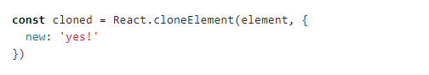
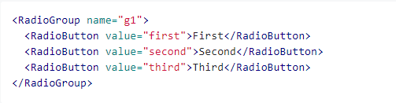
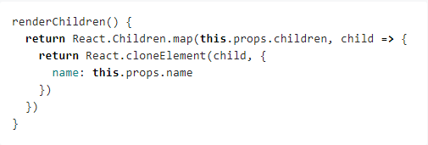
Editing children: immutably cloning elements
This is where the last helper method of today comes into play.
As the name suggests, React.cloneElement clones an element.
We pass it the element we want to clone as the first argument, and then as a second argument we can pass an object of props we want to be set on the cloned element.

Slide 44
Summary
Children make React components feel like markup instead of disjointed entities.
Using the power of JavaScript and some React helper functions we can work with them to create declarative APIs and make our lives easier.
🎉

Slide 45
Useful links
https://reactjs.org/docs/render-props.html
https://tylermcginnis.com/react-render-props/
https://www.robinwieruch.de/react-render-props
https://www.richardkotze.com/coding/hoc-vs-render-props-react
https://reactjs.org/docs/composition-vs-inheritance.html
https://frontarm.com/james-k-nelson/4-ways-pass-children-react-elements/
https://frontarm.com/james-k-nelson/passing-data-props-children/
https://mxstbr.blog/2017/02/react-children-deepdive/

Slide 46
Thank you for attention
by Yaroslav Vendysh

